Slide 1
Hpcc systems
An introduction

Slide 2

HPCC Systems Evolution
2019
2012– 2018
2011
2001– 2010
ECL Cloud IDE
Data and Process Catalog Manager
IoT Admin Manager: Nest Adapter, Ecobbe Adapter, Fitbit
100% Open Source and free of support commitment
#1 in Big Data ETL performance
#1 in low cost of ownership
#1 in support services
Enterprise Ready but the only free open source stack
Open Sourced HPCC Systems under Apache 2.0
2001
Used exclusively by LexisNexis and large data LexisNexis customers
First Version of HPCC Systems

Slide 3
Dipping into a Data Lake
Data Cleansing and Organization (ETL)
Machine Learning
Advanced Analytics
A central (logical) repository of data
Unlimited storage
Schema on read
Low cost of storage and compute
File metadata tracking
High performance processing
HPCC Systems DATA LAKE
On-premises Data Movement
Real-time Data Movement
Batch Data

Slide 4

HPCC Systems (Small to Big Data) ETL
Integrate
Profile
Clean
Standardize
Aggregate
Machine Learning
Deliver
Decreasing Content Volume
Batch Services
Relate &
Big Data
Sources
Real-time Services
Profile & Clean
Standardize
Analyze
Visualization Integration
Increasing Content Quality
Unstructured and Structured Content
HPCC Systems Data Lake
Analysis Applications

Slide 5
Anatomy of a Big Data Processing System
Big Data
Smaller Data
Compute
Divide

Slide 6

The Challenge
Use Case: Smart Hat
4,000 workers die and millions are injured annually while working on the industrial floor
$
Very high cost for maintaining safety in industrial businesses

Slide 7

The Solution + Result
Use Case: Smart Hat
Sensor-Equipped Wi-Fi Hardhats Pushing floor information to a monitoring station, which uses a prediction engine to forecast emergency situations
Factory readings and real-time alerts
Prediction Engine sends back emergency updates
Monitoring station updates
Produced an industrial wearable that uses IoT and wireless communications systems to protect and empower industrial workers

Slide 8
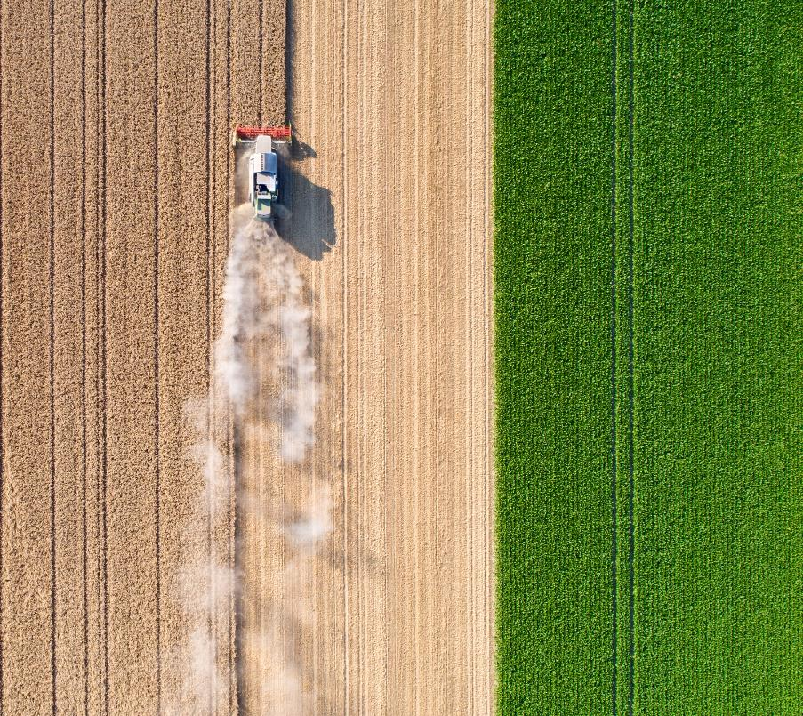

The Challenge
Use Case: Precision Agriculture
2x
Food demand will double by 2050 to feed 9.5 billion people
Climate change is causing a decline in arable land and water availability
Public discourse and policies about food waste and healthier options
$
Changing economies and diets affect how people eat

Slide 9
The Solution
Use Case: Precision Agriculture
Proagrica Consolidates, organizes and enhances vast amounts of data to drive value across the entire industry, in applications like:
Farm Management Info Systems A wide spectrum of tools used by farmers all generating data
Farm Machinery Every piece of farm equipment is now generating data and wants to be precise
Sensors Ground and animal sensors measure everything from animal fertility to soil moisture
Soil Global soil type horizons
Satellites/Drones Ability to identify issues from space
Weather Data Global current and historical weather and soil moisture data at sub-field level
Manufacturers & Distributors Adaptris manages supply chain connectivity between MFRS and their distributors
Agronomist Providing advice, shape files and data to farmers

Slide 10
The Result
Use Case: Precision Agriculture
Data Collection
Insights
Engagement
Farmer decides who has access to data
Combined data can be output in two ways
Solutions increase productivity, quality and profitability
Software
Farmer
You do the analysis
Data storage + analysis Custom algorithms Predictive analytics
Data combined for transmission/analysis
Precision Agriculture Platform
OR
Precision Agriculture Platform
An outside technology partner does your analysis
Markets • Trials • Machinery • Government Remote Sensing • Labs • Weather • Industry
Industry
Machinery

Slide 11
Mobile Strategy Games
The mobile games industry is worth billions of dollars, with companies spending vast amounts of money on the development and marketing of these games to an equally large market. This dataset includes fields such as Name, Release Date, Description, avg rating, etc.
Spotify Playlists Dataset
This dataset is based on the subset of users in the #nowplaying dataset who publish their #nowplaying tweets via Spotify. In principle, the dataset holds users, their playlists and the tracks contained in these playlists.

Slide 12

Cloud IDE
Register ECL Cloud IDE on Campus https://ide.hpccsystems.com/auth/login​​​​​​​

Slide 13
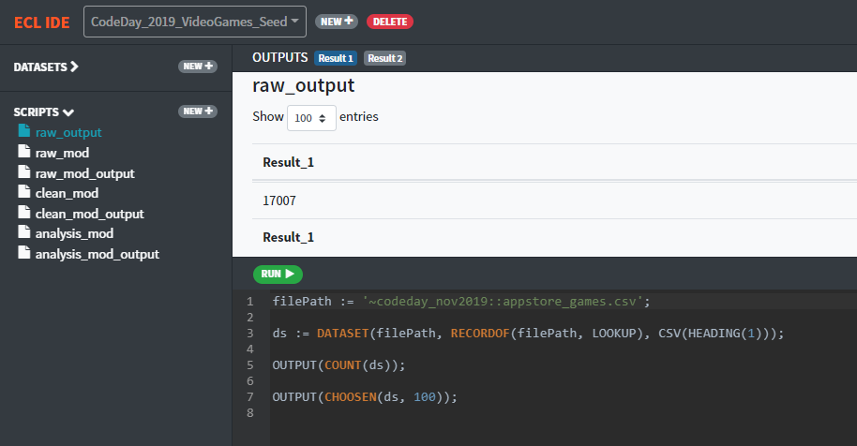
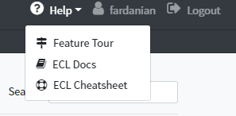
Could IDE
Please see following for more information:
https://github.com/BaharF/CodeDay_Nov2019/blob/master/CloudIDE-Setup.pdf

Slide 14
ECL
ECL is language design to query/manipulate huge data and is used for ETL(Extract, Transform, and Load) and data visualization.
ECL is not case-sensitive.
White space is ignored, allowing formatting for readability as needed.
Single-line comments must begin with //.
Block comments must be delimited with /* and */.
ECL uses the standard object.property syntax to qualify Definition scope and disambiguate field references within tables:
ModuleName.Definition //reference an definition from another module/folder
Dataset.Field //reference a field in a dataset or recordset

Slide 15
Record Structure
Defines the layout o fields in the dataset, order of the fields should be the same as the dataset.
Layout := RECORD
STRING pickup;
INTEGER fare;
END;
File Dataset
A physical data file on disk. It can be define directly, or can be brought in.
memDs := DATASET([{'2015-01-01 01:08:56', 25.10},
{'2015-01-01 02:10:22', 40.15}], Layout);
fileDs := DATASET(
'~Sample::file::scsv', Layout, CSV);

Slide 16


Filter
Layout_Person := RECORD
UNSIGNED1 PersonID;
STRING15 FirstName;
STRING25 LastName;
END;
allPeople := DATASET([ {1,'Fred','Smith'},
{2,'Joe','Blow'},
{3,'Jane','Smith'}],Layout_Person);
allPeople(LastName = 'Smith');
Sort
SortedPerson := SORT(Person, LastName, FirstName)

Slide 17
Aggregation
rec := RECORD
INTEGER Num1;
INTEGER Num2;
INTEGER Num3;
END;
DS := DATASET([{20,45,34}, {909,56,45}, {30,-1,90}], rec);
COUNT(DS); //Returns 5
MAX(DS, Num1); //Returns 909
MIN(DS, Num2); //Returns -1
AVE(DS, Num1) //Returns 319.6666666666667
TRUNCATE(AVE(DS, Num1)); //Returns 319
SUM(DS, Num1 + Num3); //Returns 1128

Slide 18
Module
The MODULE structure is a container that allows you to group related definitions. The parameters passed to the MODULE are shared by all the related members definitions.
Variable Scope:
Local definitions are visible only through the next EXPORT or SHARED definition (including members of the nested MODULE structure, if the next EXPORT or SHARED definition is a MODULE).
SHARED definitions are visible to all subsequent definitions in the structure (including members of any nested MODULE structures) but not outside of it.
EXPORT definitions are visible within the MODULE structure (including members of any subsequent nested MODULE structures) and outside of it .

Slide 19
MyMod := MODULE
SHARED x := 88;
y := 42; //local
EXPORT InMod := MODULE //nested MODULE
EXPORT Val1 := x + 10;
EXPORT Val2 := y + 10;
END;
END;
MyMod.InMod.Val1;
MyMod.InMod.Val2;

Slide 20
Transform
Specifies exactly how each field in the output record set is to receive its value.
It should include the resulttype.
Should contain name
Contains parameter list
SELF: refers to fields in resulttype.
Project
Processes through all the records in the dataset performing Transform.
LEFT: refers to dataset getting passed to Project.

Slide 21

NameRec := RECORD
STRING FirstName;
STRING LastName;
END;
NameDS := DATASET([{'Sun','Shine'}, {'Blue','Moon'}, {'Silver','Rose'}], NameRec);
NameOutRec := RECORD
STRING FirstName;
STRING LastName;
STRING CatValues;
INTEGER RecCount
END;
NameOutRec CatThem(NameRec L, INTEGER C) := TRANSFORM
SELF.CatValues := L.FirstName + ' ' + L.LastName;
SELF.RecCount := C;
SELF := L;
END;
CatRecs := PROJECT(NameDS, CatThem(LEFT,COUNTER));

Slide 22

Table
Creates a temporary dataset in memory, GROUP option can be used.
Layout := RECORD
STRING10 pickup_date;
DECIMAL8_2 fare;
DECIMAL8_2 distance;
END;
Ds := DATASET([{'2015-01-01', 25.10, 5}, {'2015-01-01', 40.15, 8}, {'2015-01-02', 30.10, 6}, {'2015-01-02', 25.15, 4}], Layout);
crossTabLayout := RECORD
ds.pickup_date;
avgFare := AVE(GROUP, ds.fare);
totalFare := SUM(GROUP, ds.fare);
END;
crossTabDs := TABLE(ds, crossTabLayout, pickup_date);

Slide 23
Join
The JOIN function produces a result set based on the intersection of two or more datasets or indexes.
Inner: Only those records that exist in both datasets.
Left Outer: At least one record for every record in the left.
Right Outer: At least one record for every record in the right.
Left Only: One record for each left record with no match in the left.
Right Only: One record for each left record with no match in the right.
Full Only: One record for each left and right record with no match in the opposite.

Slide 24
MyRec := RECORD
STRING1 Value1;
STRING1 Value2;
END;
LeftFile := DATASET([{'C','A'}, {'X','B'}, {'A','C'}], MyRec);
RightFile := DATASET([{'C','X'}, {'B','Y'}, {'A','Z'}], MyRec);
MyOutRec := RECORD
STRING1 Value1;
STRING1 LeftValue2;
STRING1 RightValue2;
END;
MyOutRec JoinThem(MyRec L, MyRec R) := TRANSFORM
SELF.Value1 := IF(L.Value1<>'', L.Value1, R.Value1);
SELF.LeftValue2 := L.Value2;
SELF.RightValue2 := R.Value2;
END;

Slide 25





Left Dataset Right Dataset
InnerJoinedRecs := JOIN(LeftFile,RightFile,
LEFT.Value1 = RIGHT.Value1,
JoinThem(LEFT,RIGHT));
LOutJoinedRecs := JOIN(LeftFile,RightFile,
LEFT.Value1 = RIGHT.Value1,
JoinThem(LEFT,RIGHT),
LEFT OUTER);
LOnlyJoinedRecs := JOIN(LeftFile,RightFile,
LEFT.Value1 = RIGHT.Value1,
JoinThem(LEFT,RIGHT),
LEFT ONLY);

Slide 26
Visualization
Methods include
Two-Dimensional
Multi-Dimensional Methods
Geospatial
General
A basic visualization typically requires the following steps:
1. Creation of a suitable dataset.
2. Output the dataset with a suitable name, so that visualization can locate the data.
3. Create (and output) a the visualization, referencing the named output from step

Slide 27
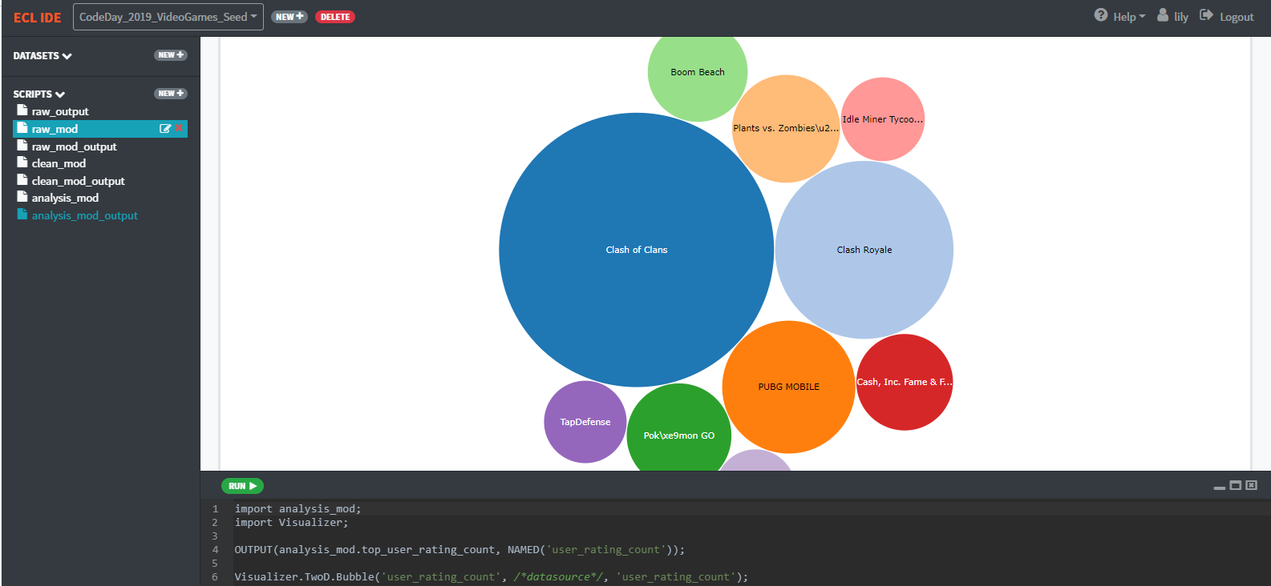
top_user_rating_count := TOPN( TABLE(clean_mod.games_ds, {name, user_rating_count}) , 10, -user_rating_count);
OUTPUT(analysis_mod.top_user_rating_count, NAMED('user_rating_count'));
Visualizer.TwoD.Bubble('user_rating_count', /*datasource*/, 'user_rating_count');

Slide 28
Reverences
Github CodeDay:
https://github.com/BaharF/CodeDay_Nov2019
ECL training containing six short videos
https://www.youtube.com/watch?time_continue=192&v=Lk78BCCtM-0
ECL document
http://cdn.hpccsystems.com/releases/CE-Candidate-7.0.24/docs/EN_US/ECLLanguageReference_EN_US-7.0.24-1.pdf
Visualization document
https://d2wulyp08c6njk.cloudfront.net/releases/CE-Candidate-7.6.2/docs/EN_US/VisualizingECL_EN_US-7.6.2-1.pdf
ECL cheat sheet
https://github.com/BaharF/CodeDay_Nov2019/blob/master/ECL_Cheat_Sheet.pdf
VS Code
https://wiki.hpccsystems.com/display/hpcc/VS+Code+and+HPCC+Systems+Installation+Cheat+Sheet

Slide 29
Thank you!
learn more at hpccsystems.com

